Slide 1
IT-Governance
(GSE-Project Highlights)
Folie <number>
Copyright GSE/Project IT-Governance
Notes:
Seite <number>
1

Slide 2

Scenario IT-Governance
IT is an intensively discussed topic in Organisations and Enterprises.
Discussion ranges from ‘cost factor’ to ‘business enabler’.
A close link between the Enterprise-Strategy and IT-strategy is key, but it
seems the distance between Enterprise-Management and IT is growing.
Top Managers come very often from the „classical“ disciplines.
CIO’s are not very often members of the Board.
For many Enterprises are „Consolidation“, „Concentration on core
business“ and „Operational Excellence“ additional priorities of today.
(But this is tightly coupled with Processmanagement, IT-Infrastructure
and IT-Skills !!)
Folie <number>
Notes:
Seite <number>

Slide 3
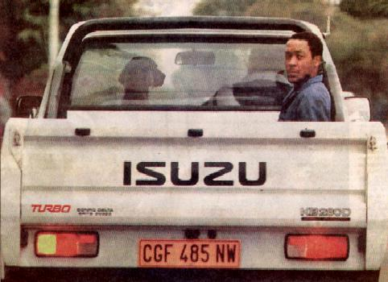
CIO
Folie <number>
Notes:
Seite <number>

Slide 4
Target/Goal of the Project
The Project „IT Governance“ is dealing with the role, the strategic positioning and the alignment of IT in/with the enterprise-strategy.
Goal of the Project :
- a Backgroundanalysis
- an estimation of Development Trends
- the identification of Successfactors and Best Practice Samples
- raise quality and influence of the CIO (IT-Department)
Creation of a representative Referencemodel for :
- the establishment of an effective IT-Strategy
- IT-Guidance
- IT-Services tightly linked to the Enterprise- Strategy.
The results will be published in a Management Summary, Q4/04.
CIO-Club, Munich 17-18.6.2004
Targetgroups are CEO’s, CIO’s
Folie <number>
Notes:
Seite <number>

Slide 5
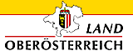


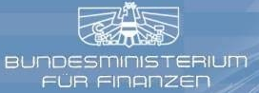















Insights on current IT Governance Trends were developed by experienced IT Managers, Business Managers and Consultants
Participating Companies
The GSE Working Group
Industry and Public Sector
Consulting Companies
Amt der
oberösterreichischen
Landesregierung
IT-Sektion
Bundespensionsamt
IT Austria
This broad range of diverse backgrounds and experiences results in a comprehensive view on IT governance with different perspectives and emphases
Folie <number>
Notes:
Seite <number>

Slide 6
Content
Inhalt
IT Strategic Alignment (IT-Governance)
IT Value Delivery (ROI, IT-Marketing, Measurement, Tools)
IT Macroorganisation (Enterprise-Focus)
IT Microorganisation (IT-Focus)
Folie <number>
Notes:
Seite <number>

Slide 7

Strategic Alignment
“IT is there to support people and processes, not the other way around.”
“The only way to justify IT-Investments is by understanding how to support the business and get customer satisfaction”
Folie <number>
GSE-IT Governance-Team1-17Okt03-DT-dt-VIE2.ppt
Notes:
Seite <number>

Slide 8
IT evolving from Support Tool into Source of
Competitive Advantage...
1.1. Role of IT
Development Exhausted Or New Future Push To Be Expected?⁽¹⁾
Source of differentiation and advantage
Airlines
Retailing
Financial
Services
Automotive
Health Care
Support core business
processes
IT
role
Support
back office
Copyright © The Boston Consulting Group
1960's
1970's
1980's
1990's
2000's
2010's
IT evolution over time
IT needs to be linked with business strategy to generate value for the business
Folie <number>
Copyright © The Boston Consulting Group
Notes:
Seite <number>

Slide 9
Increasing Strategic Relevance of IT in a Company demands for Integrated Business and IT Strategy Development → “On demand Services”
1.1. The Integrated Strategy
Separated Business- and IT-Strategies
Aligned Business- and IT-Strategy
Integrated Business and IT Strategy
Business- strategy
Business- strategy
Integrated Strategy
IT-Strategy
IT-Strategy
Integrated strategy development requires joint planning and controlling boards and processes
Folie <number>
Source: IBM Business Consulting Services
Notes:
Seite <number>

Slide 10
IT Governance manages the Interaction of all involved with IT
1.1. IT Stakeholder Interaction
Board of directors
Central functions
(Corporate strategy,
Accounting,
Controlling, HR ...)
Business units,
subsidiaries,
affiliated companies
Employees,
workers' council
Cooperation
Regulatory authorities⁽¹⁾
Internal IT service providers
(IT organization,
shared services center)
External IT service
providers
Transparency needed: roles, influence and mandate of each involved party
E. g. in Energy/utilities, health care, telecommunications, financial services
Source: BCG; GSE Arbeitskreis
Folie <number>
Notes:
Seite <number>

Slide 11
… by addressing seven Core Questions
1.1. IT Governance Circle
Overall: "How much value does IT contribute to the organization?"
"How well are the overall business strategy and IT strategy aligned?"
"How are corporate-wide architecture
standards developed and implemented
for the entire organization?"
IT Governance
IT architecture
Business
and IT
strategy
alignment
"How should the IT service portfolio be managed and controlled from a corporate perspective?"
What is the
purpose of IT for
the company?
IT planning
and
controlling
IT leader-
ship and
organization
"Which skills should be
developed and kept
internal and which
activities should be
outsourced?"
How is
IT managed?
Skills
and
sourcing
IT develop-
ment and
delivery
"How should the IT organization be structured to account for local and global needs?"
"How should BUILD, TRANSFORM, and RUN be managed? How should the development process look like? What are appropriate standards for delivery⁽²⁾ (SLAs, availability ...)?
(1) This includes the function, application, information and technology architecture (2) E. g. SLAs, availability ...
Source: BCG methodology, BCG Navigator
Folie <number>
Copyright © The Boston Consulting Group
Notes:
Seite <number>

Slide 12
Our Definition of IT Governance emphasizes the close Link of IT to the Organization as a whole ...
... but also acknowledges the Limits of IT Governance (!!)
1.2. Our Definition of IT Governance
What?
IT governance is an integral part of corporate governance and analogously combines leadership, organizational structures, and processes that ensure that IT sustains and extends the organization’s strategies and objectives
IT governance provides guidelines, establishes criteria and standards for decision making, monitoring, measuring, and improving the performance of IT
IT governance is the responsibility of the executive board and the executive management (incl. IT) and supports the interaction of all the organization's parties involved with IT
How?
Who?
What not?
Though guided by it, daily operations or operative project management, are not core part of IT governance nor can IT governance substitute for a sound business strategy
Folie <number>
(1) Vorstand Source: GSE Arbeitskreis "IT Governance"
Notes:
Seite <number>

Slide 13
Several IT Governance Frameworks with different Focus
1.3. Frameworks' Overview
Business and IT strategy integrated
Focus on strategy
IT decision structures and processes
IBM
Business and IT strategy alignment
BCG
Gartner
Giga Group
Structure of global IT organizations
Primary
objective
Focus on operations
KPMG
IT process
performance controls
and metrics
COBIT
Implementation of IT governance using CobiT, ITIL
ISO 17799
IT security management
Company
individual
ITIL
ITIL
De facto
standard
IT services management
IT focus
Business/IT alignment
Content
Each framework can be deployed in different situations accordingly
Note: A "framework" is a comprehensive concept describing options, methods, and tools to implement IT governance.
If a framework is chosen and adapted to fit a specific companies needs, we speak of a "model"
Source: GSE Arbeitskreis "IT Governance"
Folie <number>
Notes:
Seite <number>

Slide 14
The “right" IT Governance Model depends on the overall Business Context
1.4. Which model?
Business diversity
Technology trends
"How diversified is the
company?"
  Homogeneous business
  requirements or
  Heterogeneous business
  models of the different BUs
Which industry is the company in?
  Production
  Service
  Public Sector
Size of the company
"What are major technological trends and how can they be utilized in the company?"
  Strategic differentiator or
  Efficiency increase
Level of commonality across different architectural layers
IT Governance Model:
=
Company-specific adaptation
of (a) selected framework(s)
Business management model
Business imperative
"What does the overall business structure look like?"
  Financial holding with independent BUs or
  Integrated and tightly
  coupled business units
"What are the driving forces for the
company"
  Economic environment
  Competitive environment
  Customers
  Company performance
The chosen governance model may change with changing contextual factors
Folie <number>
Source: BCG methodology
Copyright © The Boston Consulting Group
Notes:
Seite <number>

Slide 15
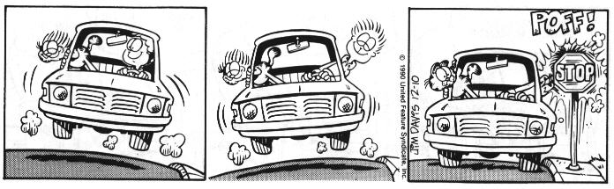
Always remember : What suits one customer might not suit the next
Folie <number>
Notes:
Seite <number>

Slide 16
IT Value Delivery
"Instead of valuing something by its cost, figure out how much it's worth."
Folie <number>
GSE-IT Governance-Team1-17Okt03-DT-dt-VIE2.ppt
Notes:
Seite <number>

Slide 17
Benefit from IT is derived exclusively via business processes it supports or enables.
2.1. IT Benefit
x
IT
Enterprise Value
IT Benefit
Business Processes
Strategic Value Drivers
Process Benefit
enables the process in the first place
increases effectiveness of the process
increases efficiency of the process
reduces risk of the process (e.g. through higher flexibility)
increases competitiveness of the enterprise as a whole
increases efficiency of the enterprise
reduces risk of the enterprise
market potential
customer value
productivity of resources
resource prices
Source: Wigand
Folie <number>
Notes:
Seite <number>

Slide 18
Types of benefit
2.1. IT Benefit
1 = Business Process Benefit (increased effectiveness and efficiency, lower risk of business process)
2 = Infrastructure Benefit (higher flexibility of the company as a whole, lower total cost, lower marginal cost for Business Unit IT)
3 = Indirect Benefit (Benefit = opportunity costs; „must-do-projects“ for legal, technological, or competitive reasons)
IT
Enterprise Value
3
1
Geschäfts-prozesse
Geschäfts-prozesse
BP-BENEFIT
Business Processes
Strategic Value Drivers
2
market potential
customer value
productivity of resources
resource prices
Infrastructure Processes
INFRASTRUCTURE BENEFIT
Folie <number>
Source: IBM Global Services
Notes:
Seite <number>

Slide 19
What elements determine the value added to the enterprise?
2.1. IT Value-Added
BENEFIT
from IT
+
IT-VALUE-ADDED
CAPITAL
invested in IT
COST
of IT
-
-
-
RISK
from IT
Source: IBM Global Services
Folie <number>
Notes:
Seite <number>

Slide 20
How do you CONTROL IT-Value added?
2.1. Controlling IT-Value-Added
VALUE-ADDED
BENEFIT
+
ITVA
Maturity of IT controlling
PROFITABILITY (ROI)
CAPITAL
-
-
COST
BENEFIT
-
+
RISK
ITVA
EFFICIENCY
CAPITAL
-
-
COST
BENEFIT
-
+
RISK
ITVA
COST
CAPITAL
-
-
COST
BENEFIT
-
RISK
+
ITVA
CAPITAL
-
-
COST
Source: IBM Global Services
-
Hint: Managing IT just as COST prevents lasting improvement of IT VALUE added.
RISK
Folie <number>
Notes:
Seite <number>

Slide 21
Lasting IT cost management requires a holistic view of the IT life cycle (Total Cost of Ownership = TCO).
2.1.Total Cost of Ownership
Sourcing Risk
Utilization Risk
Performance Risk
Cost Structure Risk
Costs of
Risk
Search and Initiation
Bargaining and Contracting
Policing/Auditing
Enforcement
Management Costs
(for External Partners)
Total Life Cycle Cost
Coordination Costs
  Organizational Structure
  People & Systems-Management
  IT Systems
Motivation Costs
  Performance Appraisal
  Cost of Conflicts
  Cost of Wrong Decisions
Management Costs
(for Internal Organization)
Production Costs
Hardware
Software
External Services
Property
„Productive“ Personnel
Cost of Capital
Folie <number>
Source: IBM Global Services
Notes:
Seite <number>

Slide 22
Total IT costs are higher than the IT budget!
2.1. Total Cost of Ownership
Sourcing Risk
Utilization Risk
Performance Risk
Cost Structure Risk
Costs of
Risk
IT costs outside IT budget
Search and Initiation
Bargaining and Contracting
Policing/Auditing
Enforcement
Management Costs
(for External Partners)
Coordination Costs
  Organizational Structure
  People & Systems-Management
  IT Systems
Motivation Costs
  Performance Appraisal
  Cost of Conflicts
  Cost of Wrong Decisions
Management Costs
(for Internal Organization)
IT costs covered by IT budget
Production Costs
Hardware
Software
External Services
Property
„Productive“ Personnel
Cost of Capital
Folie <number>
Source: IBM Global Services
Notes:
Seite <number>

Slide 23
IT Risk must be viewed from two sides: strategic and operational
2.1. Types of IT Risk
Responsibility
Top Management
Business Management
IT Management
STRATEGIC
IT Risk
= IT negatively affects the Long-term Viability
of the enterprise
„Do we have the right IT?“
Top Management
Business Management
IT Management
OPERATIONAL
IT Risk
= IT negatively affects the Operational Performance
of the enterprise
„Is our IT secure and available?“
Folie <number>
Source: IBM Global Services
Notes:
Seite <number>

Slide 24
Capital invested in IT and the „profit“ derived from IT usage determine the Return on Investment of IT
2.1. IT Capital Employed and ROI
monetary
IT BENEFIT
external
internal
IT „PROFIT“
-
IT COST
Labour
IT PROFITABILITY (ROI)
(Return on Invested IT Capital)
Material
Capital
:
Hardware
CAPITAL
invested in IT
Software
Intellectual Capital
Source: IBM Global Services
Hint: Reduce invested capital through „usage contracts“ -→ e.g. „on demand“
Folie <number>
Notes:
Seite <number>

Slide 25
IT Value Drivers (Overview)
2.1. IT Value Drivers
VALUE ELEMENTS | Strategic IT VALUE DRIVERS
IT BENEFIT | Strategic Alignment
 | Functionality
 | Service Level
 | Degree of Innovation
IT COST | Specificity
 | Complexity
 | Economies of Scale
 | Economies of Scope
 | Economies of Learning
 | Risk Taking
 | Flexibility
IT RISK | Business-/IT-Alignment
 | Cost Structure
 | Availability
 | Reliability (Integrity)
CAPITAL invested in IT | IT Sourcing Mix
Folie <number>
Source: IBM Global Services
Notes:
Seite <number>

Slide 26
IT Value-Added can be managed using 3 Levers
2.2. Levers of IT Value Management
Strategic Alignment
Effectiveness
Efficiency
„Requesting the right IT services“
„Delivering the right IT services“
„Delivering IT services right.“
Folie <number>
Source: IBM Global Services
Notes:
Seite <number>

Slide 27
The right sequence of optimization is crucial to avoiding „doing the wrong things more efficiently“!
2.2. Three Levels of IT Optimization
IT Services not required
Non-strategic IT Services
Business Strategy
Strategic Optimization
1
IT Services not required
User Requirements
Unknown IT Potential
„Requesting the right IT services“
Optimizing Effectiveness
2
Current IT Services
Requirements not met
Unknown IT Potential
„Delivering the right IT services“
Type of Service
Requirements not met
Unknown IT Potential
Optimizing Efficiency
3
Specific
Customized
Standardized
„Delivering IT services right“
IT Sourcing
Requirements not met
Unknown IT Potential
Self Sourcing
Strategic Partnerships
Market
Folie <number>
Source: IBM Global Services
Notes:
Seite <number>

Slide 28
What are Strategic Guiding Principles for IT?
2.2. Maximizing ITVA
A GOOD IT-Strategy :
states a basic belief or attitude towards using IT in the organization – in one or two clear sentences
is a guideline for action – but also allows valid arguments against it
is in non-technical language to be understood by non-IT people and IT people alike
influences corporate-wide and/or business unit-wide behaviour
has lasting effects
has objective reasons
A BAD IT-Strategy :
is a statement no one can object to („All new applications must have simple handling.“)
is too general („Total cost of IT must come down.“)
has no logical reasons = „Because I tell you“-principles
is too technically detailed and therefore quickly outdated
 Implement strategic guiding principles approved and committed to by all IT stakeholders – before optimizing effectiveness and efficiency!
Folie <number>
Source: IBM Global Services
Notes:
Seite <number>

Slide 29
The overall optimum for the organization is achieved by aligning user requirements with the strategic guiding principles.
2.2. IT Portfolio Alignment
Optimum Functionality and Service Level
Functional & Service Level Requirements of IT users
Additional Requirements
from Strategic Guiding Principles
(e.g. Security or Integration Requirements)
Requirements Cut-off
from Strategic Guiding Principles
(e.g. 80/20 Rule of Functionality)
Source: IBM Global Services
 Communicate and explain the rules for additional requirements and cut-offs!
Folie <number>
Notes:
Seite <number>

Slide 30
Benchmarking – used correctly – can deliver important information for IT controlling
2.3. IT Benchmarking
BENCHMARKING
= structured comparison for better performance
with
Own Past
Standards
Other Companies
periodic comparison of relevant measures of IT performance
standardized
„Best Practices“ –
e.g. ITIL, ITPM, COBIT
comparable key metrics (Problem: How to get relevant and comparable figures from others?)
Hint: Do not neglect „internal“ benchmarking in favour of external Benchmarking!
Folie <number>
Source: IBM Global Services
Notes:
Seite <number>

Slide 31
IT Macroorganisation
Folie <number>
GSE-IT Governance-Team1-17Okt03-DT-dt-VIE2.ppt
Notes:
Seite <number>

Slide 32
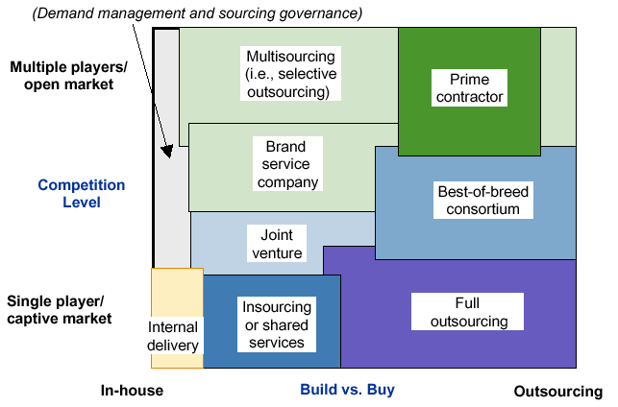
Choice of Optimal Sourcing Model …
… Depends on a Sourcing Strategy
3.2. Sourcing Strategy
The Sourcing Strategies Space and the Sourcing Models:
Competition
Level
Make or Buy
As part of their externalization strategies, worldwide and European organizations are using, and will
continue to use, not only outsourcing but also different intermediate models !
Folie <number>
Notes:
Seite <number>

Slide 33
Principles of IT Control
3.1. Principles of IT Control
federal
Strategic
IT-Management
central
local
Low customer orientation
Reinventing the wheel
Scale effects („Economies of Scale“)
Systems partially in responsibility of BUs
Bad coverage of BU-specific
requirements
Excessive total costs
Critical mass
at skills
Good coverage of BU-specific demands
Low transparency and possibility of control
of central IT-costs by BU
Different standards und competences
Enterprise
standards
priority of demands
user-controlled
No synergies and integration advantages
synergies
Enterprise-wide
IT-Strategy, Architecture and Infrastructure
Folie <number>
Notes:
Seite <number>

Slide 34

Organisation and IT Strategy
3.1. Organisation and IT Strategy
corporate strategy
An IT-Strategy is...
  ...an integral part of the corporate strategy
  …the result of a continuous planning process
  ...a navigation path for the future direction of informatics
  ...a guideline for investment decisions
  …the base for the implementation program
  ...controllable and adaptable
IT-strategy
IT-activities
IT-processes
roles
responsibilities
guidelines
decision criteria
targets
sourcing
applications
architecture
...
Source: IBM Business Consulting Services
© Copyright IBM Corporation 2003
The organisation ensures that the IT-strategy is not an isolated planning and controlling instrument, but is seen in a global context.
Folie <number>
Notes:
Seite <number>

Slide 35
High Level Governing Bodies Steer and Monitor
Implementation and Performance of IT Governance
3.1. Governing Bodies
High (leaders)
Roles/responsibilities
Governance Committees:
5–7 most senior people (usually CEO, CFO, BU presidents, CIO)
  Provides strategic oversight to corporation
    IT is only one dimension of their scope
  Aligns IT to business strategy
IT Councils:
CIO and 5–7 well respected BU managers
  Provides IT coordination across BU’s
  Establishes IT policies and enforce standards
  Prioritizes IT projects
Seniority
of members
  Chartered by IT Council
  Develops policy recommendations for IT Council
  Focused on a specific IT topic
IT Working Groups:
CIO and senior IT manager from each BU
IT Advisory Boards: 3–5 IT specialists
with 1–2 IT Council members
  Provides BU perspective to CIO
  Debates IT strategy
  Input on IT project prioritization
Top-down
Balanced
Autonomous
Low
(technical experts)
Corporate IT only
(no BU IT groups)
Corporate IT and BU IT groups
BU IT groups only
(no corporate IT)
Degree Of Centralization Drives Which Bodies are Deployed for Which Tasks !
Folie <number>
Notes:
Seite <number>

Slide 36
IT-Microorganisation
Folie <number>
GSE-IT Governance-Team1-17Okt03-DT-dt-VIE2.ppt
Notes:
Seite <number>

Slide 37
Different solutions for the organisation of the IT-Department
4.1. Gestaltungskriterien IT-Organisation
Function oriented
IT-Process oriented
E.g. Oracle-Group, Java-Group, SAP-Group
Organisation aligned with IT-Processes
E.g. Project Office for Project-management, Applicationssupport, Relationship Management, Help Desk, Operation, Engineering
Customer oriented
Businessprocess oriented
Aligning the IT-Organisation with organisational Structures on Customerside (divisional Structure)
E.g. Boards, Divisions, Departments, ..
Aligning the IT-Organisation with Customer Businessprocesses
E.g. Finance, HR, …
Folie <number>
Notes:
Seite <number>

Slide 38
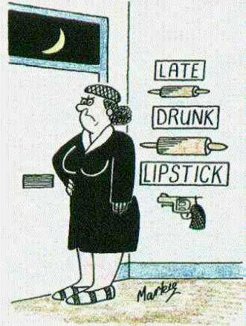
Different solutions for different situations ……
Folie <number>
Notes:
Seite <number>

Slide 39
Centralisation versus Decentralisation
4.1. Zentralisierung vs. Dezentralisierung
Centralisation for cost reasons.
Enabled by Technologie (Broadband, Internet, Mobile Computing)
Decentralisation enables Focus on specific Topics and supports a closer
relationship with the customer.
Operation with the same Know-How-Basis in decentral Structures
results in lower efficiency and professionality and will result in
higher costs
Calculation of the relevant pro‘s and con‘s, lead in our days mostly to centralisation of – at least – mission critical functions.
Folie <number>
Notes:
Seite <number>

Slide 40
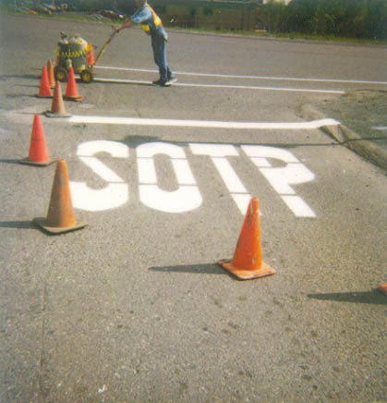
Folie <number>
Notes:
Seite <number>

Slide 41
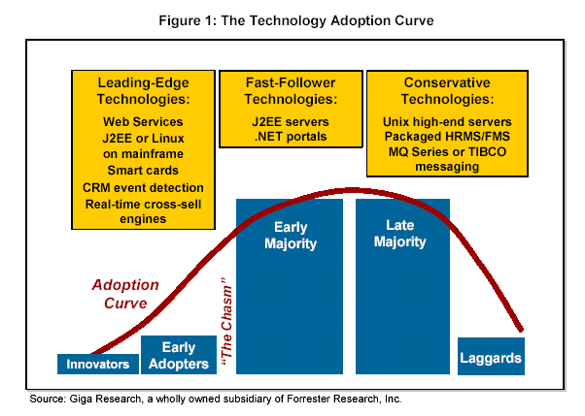
Technology Adoption
4.3. Innovator - Adopter - Follower
Folie <number>
Notes:
Seite <number>
Die Kriterien der Technologiewahl sind vielfältig. Ein Kriterium – vor allem das Risiko betreffend – ist der Reifegrad von Technologie. Auch der Reifegrad ist in Abhängigkeit von der Geschäftsstrategie zu betrachten, wie anhand der Graphik erkennbar
Allgemeine Regeln der Technologiewahl. Wenn IT Teil des Kerngeschäftes ist, ist Innovator oder Early Adopter angemessen, ansonsten konservativere Technologiepolitik

Slide 42
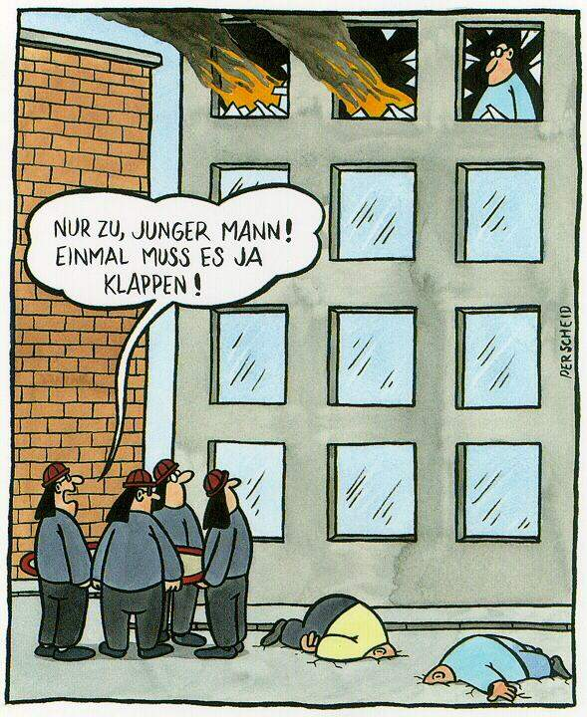
Forecasting and optimization are complex
Come on! It can‘t go
wrong every time...
Folie <number>
Notes:
Seite <number>

Slide 43
Climate, Culture and Teamspirit are Keyfactors to influence the motivation of your staff
4.2. Motivationsfaktoren
Performance
oriented
Salary
Quality
of
Leaders
Continous
education
Motivation
Flexibility
of the
working
scenario
Working
environment
Folie <number>
Notes:
Seite <number>
Die Motivation der Mitarbeiter und das Ausmaß an persönlichem Einsatz den sie für die Arbeit und das Unternehmen aufzubringen bereit sind ist ein entscheidender, aber dennoch oftmals unterschätzter Erfolgsfaktor der IT-Organisation vieler Unternehmen.
Während leistungsabhängige Gehälter mit variablen Gehaltsbestandteilen bereits sehr verbreitet sind, werden die nicht-finanziellen Faktoren, welche zur Motivation der Mitarbeiter beitragen, oftmals noch nicht ausreichend berücksichtigt.
Neben den Arbeitsinhalten selbst, der Entlohnung und weiteren „harten“ Faktoren wie Weiterbildungs- und Entwicklungsmöglichkeiten im Unternehmen ist die Arbeitsumgebung selbst ein entscheidendes Kriterium für die Zufriedenheit und Verweildauer der Mitarbeiter im Unternehmen.
Faktoren wie die Unternehmenskultur, die Positionierung und das Prestige des Unternehmens in der jeweiligen Branche, Flexibilität und Arbeitsbedingungen sowie die Qualitäten der Führungskräfte sind nur einige dieser Faktoren.
Während nach wie vor die meisten IT-Mitarbeiter primär interessante inhaltliche bzw. technische Herausforderungen und Projekte bei marktüblicher Entlohnung suchen, sind diese Faktoren alleine nicht ausreichend um Mitarbeiter zu motivieren und ans Unternehmen zu binden.
Die Gestaltung eines attraktiven Arbeitsplatzes ist ebenso entscheidend. Das Verhältnis zu den Kollegen, persönliche Freiräume und nicht zuletzt die „Softskills“ der Führungskräfte sind Faktoren, die oftmals Mitarbeiter auch neben einer adäquaten Entlohnung zu hohem und langfristigen Einsatz in und für ein Unternehmen bewegen.
Die Attraktivität des Arbeitsplatzes kann aber auch durch teambildende bzw. teamgeistfördernde Maßnahmen aktiv beeinflusst werden. Wichtig dabei ist, dass diese Events nicht zu groß (im Sinne der Anzahl der teilnehmenden Personen) angesetzt werden. Veranstaltungen auf Gruppen- oder Abteilungsebene sind in der Regel zielführender als Events, die für das gesamte Unternehmen angesetzt werden. Neben der Gruppengröße ist auch die Durchmischung der Mitarbeiter zu überlegen: soll der Teamgeist abteilungsintern gefördert werden oder soll die Zusammenarbeit innerhalb des Unternehmens über Abteilungen hinweg verbessert werden. Darüber hinaus sind auch Überlegungen hinsichtlich der Inhalte (reine Spaßveranstaltung vs. Arbeitsmeetings) anzustellen. In jedem Fall aber sind eine gute Planung und Vorbereitung wesentliche kritische Faktoren für einen nachhaltigen Erfolg derartiger Veranstaltungen. Je stärker der teambildende Aspekt im Vordergrund steht, umso eher sollte der Einsatz professioneller externer Unterstützung durch spezialisierte Trainer überlegt werden.
(Kommunikation aus anderen Bereichen des Unternehmens, um Einblick in die „anderen“ Unternehmensteile zu gewähren)

Slide 44
Clearly formulated jobdescriptions helps to select people with the right mix of Hard- and Softskills
4.2. Rollenbeschreibungen
Skill demands has to be linked closely with the future function in the
IT-Organisation
The needed skills has to be defined according to the jobprofile :
  Should be the base for Recruiting
  and for further HR-Processes (education)
Beside technical skills so called „Soft Skills“ has an increasing importance.
Samples are :
  Teamcompetence
  Stresshandling abilities
  Socialcompetence
Assessment Centers are a good instrument, to rate especially these
„Soft Skills“.
Folie <number>
Notes:
Seite <number>
Die Anforderungen, die an neue Mitarbeiter gestellt werden, sind eng mit der Rolle verbunden, die ein Mitarbeiter zukünftig innerhalb der IT-Organisation einnehmen soll. Die Rollen entsprechen im wesentlichem dem Tätigkeitsgebiet des Mitarbeiters und können von einem Einsatz als Techniker oder Entwickler über einen Einsatz als Berater oder Kundenbetreuer bis zu Tätigkeiten in den Bereichen IT-Planung/Strategie reichen. Alle in Zusammenhang mit einer jeweiligen Rolle gewünschten bzw. geforderten Skills sollten in entsprechenden Rollenprofilen festgelegt werden, die einerseits als „Steckbrief“ für das Recruiting, aber auch als wichtiger Input für weitere HR-Prozesse wie Aus-und Weiterbildung dienen.
Während technische Skills von Bewerbern relativ leicht geprüft werden können, gewinnen auch weiche Faktoren („Soft Skills“) wie Teamfähigkeit, Verhalten in Stresssituationen und Sozialkompetenz zunehmend an Bedeutung für Mitarbeiter im Bereich IT.
Assessment Center, die vormals dem Recruiting von Management Positionen vorbehalten waren, werden zunehmend für das Recruiting von IT-Mitarbeitern eingesetzt, um speziell diese weichen Faktoren kritisch zu durchleuchten.
(Bewertung externer Berufserfahrung)

Slide 45
Time, Competence and Know-how-Transfer are the main criteria for all Sourcing Evaluations
4.2. Sourcing-Kriterien
Employ staff
Buy Services
Position = Corecompetence
Specific BusinessKnow-how
Spezific Know-how will be built up and further used.
Limited ressource demand
Technical experts
Cost evaluation
Knowledgetransfer
Folie <number>
Notes:
Seite <number>
Die Entscheidung für welche Skills Mitarbeiter am Markt gesucht oder intern ausgebildet werden sollen und welche Skills über externe Dienstleister zugekauft werden sollen (Sourcing), ist eng mit der Entscheidung hinsichtlich der Kernkompetenzen eines Unternehmens verbunden. Viele Unternehmen betrachten beispielsweise die Anwendungsentwicklung heute nicht mehr als Kernkompetenz der IT-Abteilung und vergeben diesbezügliche Aufträge an externe Dienstleister.
Neben der Entscheidung hinsichtlich der Kernkompetenzen der internen IT-Abteilung sind die Dauer und insbesondere die damit verbundenen Kosten der benötigten Leistungen weitere entscheidende Kriterien bei Sourcing-Überlegungen. Während die Inanspruchnahme externer Unterstützung bei kurzfristigen Einsätzen wie z.B. zur Überbrückung von Kapazitätsengpässen lohnend sein kann, begünstigt aus Kostengesichtspunkten eine zunehmend länger werdende Einsatzdauer in der Regel den Aufbau interner Ressourcen.
Aber nicht nur die geplanten Kosten sollen ein Kriterium bei der Entscheidung hinsichtlich interner vs. externer Besetzung sein, sondern auch die Know-How-Thematik muss hier sehr bewusst eingebracht werden. Es ist die Bedeutung der Erhaltung des im Rahmen der Tätigkeit erarbeiteten Wissens für das Unternehmen zu bewerten und ggf. ebenfalls in einer Kostensicht zu betrachten.
Die vieldiskutierten Sourcing-Überlegungen, also ob und wann interne oder externe Ressourcen herangezogen werden sollen, sind meist komplex und erfordern daher ein Rahmenwerk bzw. eine rationale und strukturierte Vorgehensweise. Im Kern geht es darum zu erkennen, welche Kompetenzen in Zukunft benötigt werden, welche derzeit im Unternehmen vorhanden sind und wie Lücken durch Ausbildungsmaßnahmen oder Zukauf geschlossen werden können.
Während technische Skills auch in neueren Technologien in der Regel leicht und kurzfristig zugekauft werden können, ist dies bei Positionen, die ein tiefgehendes Branchen- oder Prozess Know-How erfordern im allgemeinen nicht der Fall.
Je höher das Ausmaß an gefordertem Business Know-How, um so eher empfiehlt sich die Einstellung neuer bzw. die Aus- und Weiterentwicklung bereits vorhandener Mitarbeiter, wodurch der längerfristigen Personalplanung und –entwicklung erhöhte Bedeutung zukommt.

Slide 46
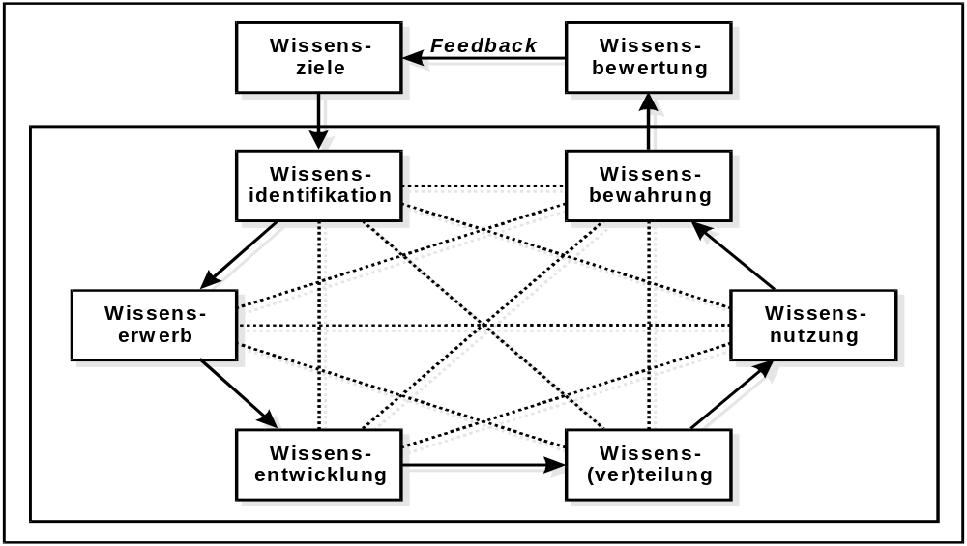
Coreprocesses of Knowledgemanagement has to be implemented in the IT-Department
4.4. Gelebtes Wissensmanagement
Know-How
Value
estimate
Identification
Store
Collection
Use
Development
Distribution
Folie <number>
Notes:
Seite <number>
Unternehmen sind bemüht mittels Personalentwicklungsmaßnahmen wie interne/externe Weiterbildung auch längerfristig sicherzustellen, dass Mitarbeiter mit den richtigen Skills zur richtigen Zeit zur Verfügung stehen. IT-Mitarbeiter sind zunehmend um Aufrechterhaltung bzw. Steigerung ihres Marktwertes bemüht, der auf technischen Fähigkeiten und Wissen aber auch auf Erfahrungen (wie z.B. interessante Projekteinsätze) beruht.
Eine der Aufgaben der Personalentwicklung ist es, diese beiden Interessen in Einklang zu bringen. Eine Möglichkeit dazu besteht in der Entwicklung von Karrierepfaden und in Einklang mit diesen, die Entwicklung individueller Weiterbildungsmaßnahmen.
Neben Karrierepfaden für zukünftige Führungskräfte (typischerweise Linien-Manager) entwickeln führende Unternehmen auch spezielle Karrierepfade für Experten und stimmen ihr internes und externes Ausbildungsprogramm auf diese Entwicklungsmöglichkeiten ab. Aufbauend auf einem entsprechenden mehrstufigen Weiterbildungsprogramm werden dafür auch zunehmend interne Zertifizierungsprogramme entwickelt, welche neben spezifischen theoretischen Kenntnissen auch Praxis-Erfahrungen mit einbezieht. Diese Zertifizierungsprogramme zeichnen für die Mitarbeiter ganz klar ihre persönlichen Entwicklungspfade vor. Mitarbeiter, denen Karrierepfade im Unternehmen klar aufgezeigt werden, sind auch eher bereit für definierte Zeiträume Tätigkeiten zu übernehmen, die zwar generell als weniger attraktiv empfunden werden, für ihre persönliche Entwicklung jedoch als wertvoll bzw. unabdingbar eingestuft werden.
Beispielgebend bei der Entwicklung von Karrierepfaden für Fachexperten sind oft internationale IT Beratungs- und Dienstleistungsunternehmen. In einem konkreten Fall wurden beispielsweise durch die Einführung von „Professions“ die Personalentwicklungsmaßnahmen auf die Rollen der Mitarbeiter noch feiner abgestimmt. Ein IT-Berater kann beispielsweise die Profession „IT Architect“ oder „Software Engineer“ wählen, aus der sich dann weitere Aus- und Weiterbildungsmaßnahmen sowie konkrete persönliche Ziele ableiten. Neben spezifischen Ausbildungs- und Zertifizierungsprogrammen je Profession dienen sogenannte „Communities“ für einen kontinuierlichen Know-how-Transfer von Praxis-Erfahrungen im Unternehmen sowie zur stärkeren Identifikation der Mitarbeiter mit dem Unternehmen selbst.
Bei der Definition der Karrierepfade und den damit verbundenen Anforderungen an die Fähigkeiten der Mitarbeiter ist dabei sehr spezifisch auf deren Einsatzgebiet Rücksicht zu nehmen. Insbesondere ist bei Mitarbeitern, die entweder eine Schnittstellenfunktion zu den Leistungsempfängern der IT-Abteilung wahrnehmen (wie z.B. Kundenbetreuer, Projektleiter) oder die Linienmanagementaufgaben ausüben, die Entwicklung und Förderung der notwendigen Softskills zu berücksichtigen.

Slide 47
Provision of Know-How is only successful, if people are willing to use it
4.4. Reuse-Kultur
Not Invented Here (or „NIH-Factor“) refers to the problem when people in companies continue to ignore existing solutions to problems because it was not created in-house.
It is endemic to the computer industry.
(See also: www.wikipedia.org)
Inventing the wheel again and again and again ……
Indicators for a good Reuse-Culture are :
Decreasing percentage of selfwritten applications
Selfdevelopments based on Standards und Objects
Check for available/usable solutions is part of the Softwaredevelopment-process
Folie <number>
Notes:
Seite <number>
Unternehmen sind bemüht mittels Personalentwicklungsmaßnahmen wie interne/externe Weiterbildung auch längerfristig sicherzustellen, dass Mitarbeiter mit den richtigen Skills zur richtigen Zeit zur Verfügung stehen. IT-Mitarbeiter sind zunehmend um Aufrechterhaltung bzw. Steigerung ihres Marktwertes bemüht, der auf technischen Fähigkeiten und Wissen aber auch auf Erfahrungen (wie z.B. interessante Projekteinsätze) beruht.
Eine der Aufgaben der Personalentwicklung ist es, diese beiden Interessen in Einklang zu bringen. Eine Möglichkeit dazu besteht in der Entwicklung von Karrierepfaden und in Einklang mit diesen, die Entwicklung individueller Weiterbildungsmaßnahmen.
Neben Karrierepfaden für zukünftige Führungskräfte (typischerweise Linien-Manager) entwickeln führende Unternehmen auch spezielle Karrierepfade für Experten und stimmen ihr internes und externes Ausbildungsprogramm auf diese Entwicklungsmöglichkeiten ab. Aufbauend auf einem entsprechenden mehrstufigen Weiterbildungsprogramm werden dafür auch zunehmend interne Zertifizierungsprogramme entwickelt, welche neben spezifischen theoretischen Kenntnissen auch Praxis-Erfahrungen mit einbezieht. Diese Zertifizierungsprogramme zeichnen für die Mitarbeiter ganz klar ihre persönlichen Entwicklungspfade vor. Mitarbeiter, denen Karrierepfade im Unternehmen klar aufgezeigt werden, sind auch eher bereit für definierte Zeiträume Tätigkeiten zu übernehmen, die zwar generell als weniger attraktiv empfunden werden, für ihre persönliche Entwicklung jedoch als wertvoll bzw. unabdingbar eingestuft werden.
Beispielgebend bei der Entwicklung von Karrierepfaden für Fachexperten sind oft internationale IT Beratungs- und Dienstleistungsunternehmen. In einem konkreten Fall wurden beispielsweise durch die Einführung von „Professions“ die Personalentwicklungsmaßnahmen auf die Rollen der Mitarbeiter noch feiner abgestimmt. Ein IT-Berater kann beispielsweise die Profession „IT Architect“ oder „Software Engineer“ wählen, aus der sich dann weitere Aus- und Weiterbildungsmaßnahmen sowie konkrete persönliche Ziele ableiten. Neben spezifischen Ausbildungs- und Zertifizierungsprogrammen je Profession dienen sogenannte „Communities“ für einen kontinuierlichen Know-how-Transfer von Praxis-Erfahrungen im Unternehmen sowie zur stärkeren Identifikation der Mitarbeiter mit dem Unternehmen selbst.
Bei der Definition der Karrierepfade und den damit verbundenen Anforderungen an die Fähigkeiten der Mitarbeiter ist dabei sehr spezifisch auf deren Einsatzgebiet Rücksicht zu nehmen. Insbesondere ist bei Mitarbeitern, die entweder eine Schnittstellenfunktion zu den Leistungsempfängern der IT-Abteilung wahrnehmen (wie z.B. Kundenbetreuer, Projektleiter) oder die Linienmanagementaufgaben ausüben, die Entwicklung und Förderung der notwendigen Softskills zu berücksichtigen.

Slide 48
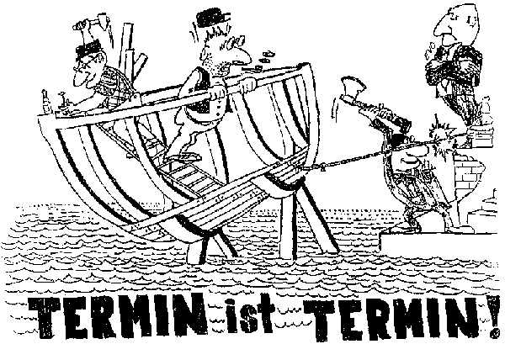
It‘s a cultural change - don‘t set too ambitious deadlines !
Deadline is deadline !
Folie <number>
Notes:
Seite <number>

Slide 49
How will „On Demand“
change the
classical IT-Governance model ?
How will „On Demand“ change the classical
IT-Governance model ?
Folie <number>
Notes:
Seite <number>

Slide 50
Forget how it‘s called ……
On Demand Business
Adaptive Enterprise
Agile Enterprise
Realtime Enterprise
Zero-Latency Enterprise
Folie <number>
Notes:
Seite <number>

Slide 51
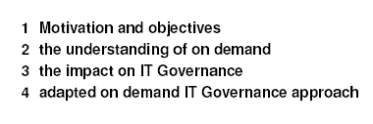
Three important Steps
Folie <number>
Notes:
Seite <number>

Slide 52
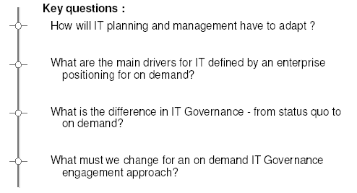
Four keyquestions
Folie <number>
Notes:
Seite <number>

Slide 53
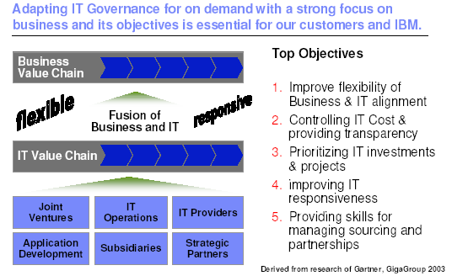
Folie <number>
Notes:
Seite <number>

Slide 54
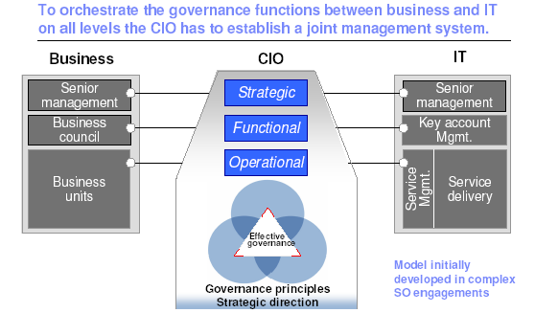
Folie <number>
Notes:
Seite <number>

Slide 55
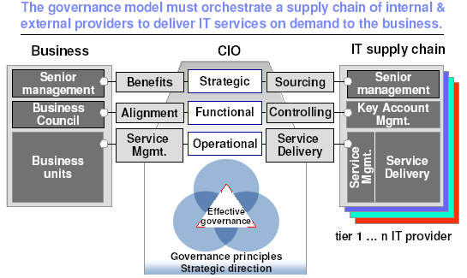
Folie <number>
Notes:
Seite <number>

Slide 56
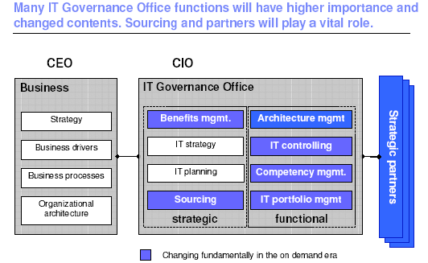
Folie <number>
Notes:
Seite <number>

Slide 57
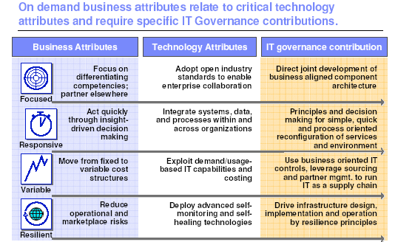
Folie <number>
Notes:
Seite <number>

Slide 58
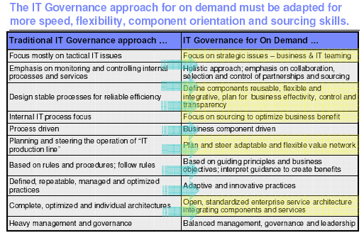
Folie <number>
Notes:
Seite <number>

Slide 59
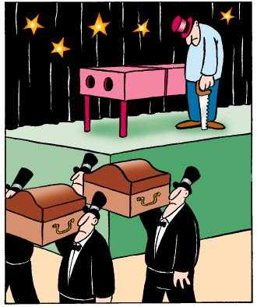
Not every presentation is successful ........
……. I hope you enjoyed this one
Thank you !
Folie <number>
Notes:
Seite <number>

